Slide 1
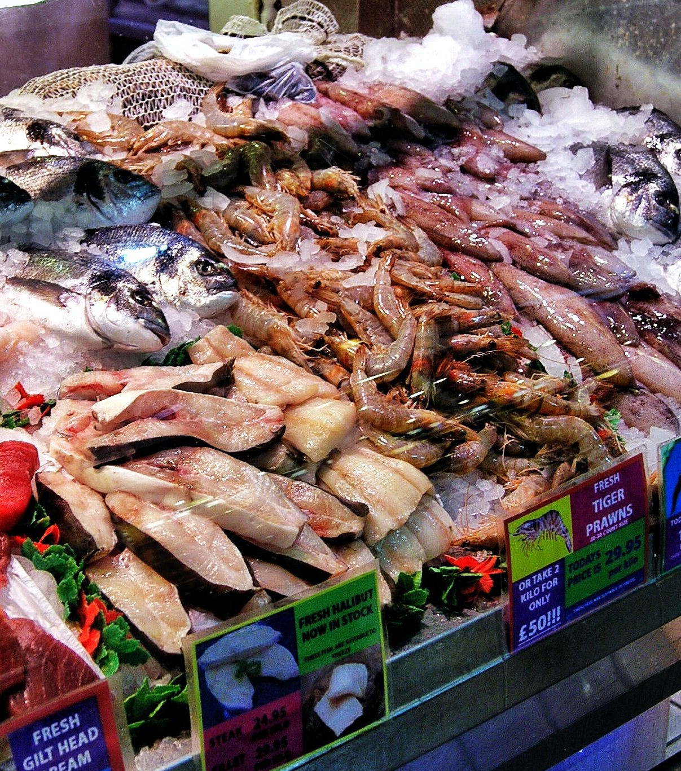
Levy Review Stakeholder Survey Analysis
SURVEY REPORT
December 23 | www.whitespacestrategy.com

Slide 2
Disclaimer

Slide 3
Contents
Research Context
Research Summary
Survey Response Analysis

Slide 4
Research Context

Slide 5
Research Context
Methodology
Background
Methodology overview
Seafish carried out a Strategic Review in 2021: One outcome was the acknowledged need to update the levy system
Seafish has proposed changes to the levy structure and administration, and is consulting with their stakeholders on the changes
Alongside this, Seafish has decided to conduct a survey to give industry stakeholders the opportunity to give feedback on the changes
Seafish asked White Space to support with the creation, field management, and analysis of the survey
15-question survey (including some optional answers) completed by 96 Seafish invitees during March and April 2023
This presentation summarises the survey responses, including some analysis of differences in responses between respondent types
This analysis is based on answers given to five introductory questions about the interviewees (location, industry, levy-paying, role and size)
This deck is not designed to provide recommendations for your strategy based on these responses, only a summary and analysis of the responses

Slide 6
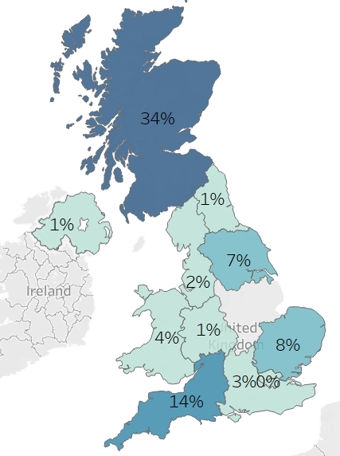
The survey received 96 complete responses from a range of senior seafood stakeholders in the UK
Sample Detail
96 people completed the survey between 13/03/23 and 24/04/23. The survey was fielded on the Alchemer platform, with participation encouraged by Seafish through emails to their newsletter list. There were 302 click-throughs in total and 208 survey starts. People were not provided an incentive to complete the survey
Role in org
65% Directors
24% Middle Managers
11% Other
% levy payers
Location
Org size
Types of org
24% ‘Whole of UK’
Micro (0-9) | 38%
SME (10-249) | 45%
Large (250+) | 17%
Processing seafood | 28%
Catching | 18%
Importing/exporting seafood | 16%
Trade (including wholesale) | 8%
Aquaculture | 6%
Other | 24%
Source: White Space Survey, Q1-5

Slide 7
Research Summary

Slide 8
The majority of respondents do not oppose the proposed changes to the Seafish Levy
Summary Conclusions
A minority of respondents were unsupportive of the proposed group of changes
Elements which had more support:
Increasing the scope of the Levy
Including canned, bottled & pouched products
Simplifying the Levy
Grouping seafood products into Cat. 1
Online Administration
Make & submit returns online
Of all respondents:
Respondents could see the benefits of a simpler system that was easier to engage with
73% Supportive or Neutral
60% Supportive or Neutral
90% Supportive or Neutral
45% of respondents were unsupportive / extremely unsupportive of the changes
SMEs and processing companies were most likely to be unsupportive
People supportive of the proposed changes included both current levy payers and non-payers
Elements which had less support:
Changes to the levy rate for Cat. 1
Base rate for Cat. 1 set at 1p/kg
Automatic inflationary adjustment
Of all respondents:
47% Unsupportive
49% Unsupportive
Concerns about cost increases at a time when some are struggling
We would expect this survey to over-represent the level of unsupportive feeling in the whole population of stakeholders. People who feel strongly about the proposed changes are more likely to be motivated to complete the survey
Builds to proposals included adding salmon to the levy, and ensuring the levy administration is made simpler than now – particularly around reducing form filling and not increasing the amount of information that needs to be provided
Some proposals received a large ‘neutral’ response. This appears to be because they would not be relevant to some respondents – e.g. definition of wholesale and Cat. 2 rate and phasing
Source: White Space Survey
Respondents who answered ‘Don’t Know’ were excluded

Slide 9
Survey Response Analysis

Slide 10
Q7: How would you describe your level of support for each of the following proposed changes to the current levy?
Proposed Changes - Support
Including canned, bottled and pouched products was broadly supported across organisation types, and was favoured by large organisations (70% supportive)
Including all canned, bottled, and pouched products in the levy
Grouping of all seafood species (besides fishmeal) into Category 1
Single base levy rate being set at 1p/kg for Category 1
Streamlining product states for finfish
Single base levy rate being set at 0.350p/kg for Category 2
An annual automatic inflationary adjustment to the levy (capped at 2%)
Phased base rate increases for whelks, pelagic species and cockles & mussels
Questions with a high proportion of neutral responses (30-40%) could indicate a lack of relevance to broad parts of the seafood industry
28% of survey responses were from processing organisations. These organisations were especially critical of a single base levy rate at 1p/kg for Category 1 (77% unsupportive), and the proposed inflationary adjustment (72% unsupportive)
NB: 8.3% of respondents stated that they were ‘extremely unsupportive’ of all proposals – this should be considered if sharing figures outside the context of this survey
Source: White Space Survey, Q7
Respondents who answered ‘Don’t Know’ were excluded

Slide 11
Q8&9: You said you do / do not support some areas of the proposed changes, can you give us some detail on why?
Proposed Changes - Concerns
Reasons given by respondents who said they do not support…
…grouping of all seafood species into one category:
Product margins vary, so would prefer a range of levy %s
Trout & salmon excluded
Bad timing for businesses
“Totally unfair when there is such a large range of prices for each product. 4 grades of haddock can have such a different price range - but pay the same levy for example”
Sr Manager, Catching Company, Scotland
…the single base levy rate being set at 1p/kg for Category 1:
Some products see large jump in levy
Not proportional to value from Seafish
Bad timing for industry dealing with other cost pressures
“Increase of 10% on our main products. it's a large jump in a sector that has seen costs increase across the board. Whelks would be over 100% increase”
Director, Processing Company, Scotland
…the single base levy rate at 0.350p/kg for Category 2:
Perceived preferential treatment for one low-value product over others
Could be double-paying on waste fish
“A fair bit of fishmeal comes from using waste streams from primary fish processing. Levy will already have been paid on that fish, so it shouldn't be charged again”
Director, Processing Company, Yorkshire & The Humber
…the phasing of the base rate increase for whelks, pelagic species and cockles & mussels
Concerns only about the rate, not phasing
“Regardless of phasing the ridiculously high take remains”
Sr Manager, Processing Company, Scotland
…the streamlining of product states for finfish
No clear communication explaining views
“The levy should be set against product value as a percentage, not a flat rate”
Director, Catching Company, Scotland
…applying an automatic inflationary adjustment of 2% to the levy
Reduces incentive to improve service
Levy should be tied to market prices
Current rise is sufficient
Not proportional to value from Seafish
“I’m struggling to increase my sales in a flat market and you want annual increases regardless of what the industry faces”
Director, Processing Company, N. E. England
…including all canned, bottled, and pouched products in the levy
Perception that this may result in the levy being applied twice
“This feels like scope to charge levy twice”
Director, Trading Company, Whole of the UK
Reasons respondents supported some / all of the proposed changes
See the benefits of a simpler system
Levy rise is necessary for Seafish and is overdue
Inflationary adjustment avoids sporadic changes
“I support inflation-linked rate increases, they make sense and stop shock loading the system at a later date”
Director, Catching Company, S. E. England
Source: White Space Survey, Q8, Q9

Slide 12
Q10: Are there any species you think should be included in the levy which are not included in the proposed changes?
Proposed Changes - Species
Salmon was the most common response for a species that should be included in the levy
67% of question respondents suggested salmon should be included in the levy. Salmon was viewed as benefiting from Seafish’s promotion of fish without contributing, and also due to salmon spending time in salt water
Respondents also acknowledged the difficulty of bringing salmon into the levy
“Of course, always and forever, salmon - its utterly absurd for it not to be subject to the levy. It free rides massively on the wider seafood positive messages”
Director/Owner, Aquaculture Organisation, Wales
“There surely must be a way that the farming of all salmon can amended within the fisheries act as it no longer is applicable. They are not migrating and often spending more time in salt water then fresh”
Senior Manager, Education/Research Organisation, Wales
“Salmon. But it is understood that their no chance whatsoever of Salmon industry here in Scotland coming under and paying levy to Seafish. It is well known in industry circles that Scottish Government would not agree to that”
Director/Owner, Catching Organisation, Scotland
31% of question respondents also pushed for other freshwater species including trout to be part of the levy
Specific other species mentioned included:
“You should be pursuing change in the legislation for trout and salmon. It seems you feel this is to great a challenge to push....just because the challenge is hard doesn't mean you should give up before you have tried
Director/Owner, Catching Organisation, S.W. England
Basa/ Pangasius
Trout
Tilapia
Warm Water Prawn
Source: White Space Survey, Q10

Slide 13
Q11: How would you describe your level of support for each of the following proposed changes to levy administration?
Administration Changes - Support
Make and submit returns online
All importers/wholesalers are required to comply
Levy is due on all seafood domestically landed into the UK
Amend the definition of "wholesale merchant"
Implement a de minimis threshold
List the individual species on which levy is due and their country of origin
Online returns was equally popular among organisations of all sizes – Micro (74% support), SME (73%) and Large (79%)
SMEs were most likely to not support a levy on all seafood domestically landed (37% unsupportive)
SMEs (37% unsupportive) and Importers/Exporters (36% unsupportive) were more likely to not support the change to list out individual species
NB: 9.4% of respondents stated that they were ‘extremely unsupportive’ of all proposals – this should be considered if sharing figures outside the context of this survey
Source: White Space Survey, Q11
Respondents who answered ‘Don’t Know’ or ‘Not Applicable’ were excluded

Slide 14
Q12: Are there any other improvements that would make the levy system easier for you to comply with?
Administration Changes - Suggestions
The majority of question respondents did not require any improvements to the current levy administration
The most commonly mentioned improvement area was:
54% of question respondents* did not require changes to the levy administration
“The levy system is relatively easy to comply with at the moment”
Director/Owner, Catching Organisation, Scotland
“The system for logging is very simple as it is, I feel the system that is already in place is easy enough to comply with so I have no input for making it better”
Senior Manager, Ports & Markets Organisation, N.W. England
“Currently, we do our levy returns monthly via email. They are normally completed within 2-3 days of post period month end, and this is a very efficient and effective process”
Senior Manager, Seafood Processing Organisation, All of UK
Simplification / no further complication
“We wouldn't want it to move to an online process, unless it is as streamlined as it is now or better. Breaking down the levy return by species and including country of origin information against each species would create significantly more work on the monthly returns”
Senior Manager, Seafood Processing Organisation, All of UK
“An improvement would be not having to fill out 3 different pages for 1 small day boat landing with the whole catch being sometimes less than 4 kg in total”
Senior Manager, Seafood Retail Organisation, S.W. England
“Not having to specify the country of origin, just the continent”
Director/Owner, Importing/Exporting Seafood Organisation
“Going forward we need a system that isn't time consuming for our staff”
Director/Owner, Catching Organisation, Scotland
*only responses relevant to the question were counted in analysis
Source: White Space Survey, Q12

Slide 15
Q13: How supportive do you feel about the proposed changes?
Overall Support
Education/ Research, Ports & Markets, Retail and Local Government respondents were the strongest supports of the proposed changes*
Large organisations (>250 employees) were the most likely organisation size to support the changes (56% supportive)
Catching organisations were the most likely organisation type to view the changes neutrally (24% neutral)
SMEs (10-250 employees) were the most likely organisation size to oppose the changes
(61% unsupportive)
Seafood Processing organisations were the most opposed group to proposed changes (65% unsupportive)
Overall, 55% of respondents were either positive or felt neutral about the proposed changes to the levy
Source: White Space Survey, Q13
Respondents who answered ‘Don’t Know’ were excluded
*low sample size for these organisation types

Slide 16
Q13: How supportive do you feel about the proposed changes? (cut by levy payers / non-payers)
Overall Support
Current levy payers were the most likely to be very unsupportive of the changes (34% very unsupportive), but 49% were supportive or neutral
Levy Payer? | Supportive | Neutral | Unsupportive
Currently Pay (n=65) | 26% | 23% | 51%
Never Paid (n=20) | 65% | 10% | 25%
Non-levy payers were the most likely to be very supportive of the changes (40% very supportive)
Unsurprisingly, people who pay the levy were more likely to be unsupportive of the group of changes to the levy. It’s reassuring to see that around half of respondents are supportive or neutral about the changes, indicating that in the population there is likely to be a majority of payers who support or are neutral about the changes
Source: White Space Survey, Q13

Slide 17
Q7: How would you describe your support for each of the proposed changes to the current levy? (large levy payers)
Large Organisations- Support
Responses of large levy-paying organisations
Q1: Which of the following best describes your organisation? | Q4: Which part of the UK do you mainly operate in? | Q7a: The grouping of all seafood species (besides fishmeal) into Category 1 | Q7b: The single base levy rate being set at 1p/kg for Category 1: All species and their products | Q7c: The single base levy rate being set at 0.350p/kg for Category 2: Fishmeal | Q7d: Proposed phased base rate increases for whelks, pelagic species and cockles & mussels | Q7e: Streamlining product states for finfish | Q7f: Applying an annual automatic inflationary adjustment to the levy (capped at 2%) | Q7g: Including all canned, bottled, and pouched products in the levy | Q13: Bearing in mind all the proposed levy changes described, including what would be collected and how it would be administered; how supportive do you feel about the proposed changes?
Foodservice | All of UK | Unsupportive | Unsupportive | Extremely Unsupportive | Extremely Unsupportive | Neutral | Extremely Unsupportive | Extremely Unsupportive | Neutral
Processing seafood | North East of Scotland | Don't Know | Don't Know | Don't Know | Don't Know | Don't Know | Don't Know | Don't Know | Unsupportive
Processing seafood | East of England | Neutral | Extremely Unsupportive | Neutral | Neutral | Neutral | Extremely Unsupportive | Neutral | Extremely Unsupportive
Processing seafood | Yorkshire & The Humber | Extremely Supportive | Extremely Supportive | Extremely Unsupportive | Neutral | Neutral | Unsupportive | Extremely Supportive | Supportive
Processing seafood | North East of Scotland | Extremely Unsupportive | Extremely Unsupportive | Don't Know | Extremely Unsupportive | Extremely Unsupportive | Extremely Unsupportive | Extremely Supportive | Extremely Unsupportive
Processing seafood | North East of Scotland | Supportive | Supportive | Supportive | Supportive | Supportive | Supportive | Supportive | Supportive
Processing seafood | All of UK | Extremely Supportive | Supportive | Supportive | Neutral | Supportive | Neutral | Extremely Supportive | Neutral
Processing seafood | South West of England | Extremely Unsupportive | Unsupportive | Supportive | Extremely Unsupportive | Supportive | Extremely Unsupportive | Extremely Supportive | Extremely Unsupportive
Trade (including wholesale) | All of UK | Extremely Supportive | Extremely Supportive | Extremely Supportive | Extremely Supportive | Extremely Supportive | Extremely Supportive | Extremely Supportive | Extremely Supportive
Source: White Space Survey, Q7

Slide 18
Q14&15: Select up to three of these areas which you expect will be the highest priority for your business over the next 3-5 years
General Needs
Fisheries management
Safe and skilled workforce
Supply chain resilience
International trade
Responding to reputational changes
Climate change
Data, insight and innovation
Especially important for Importers & Exporters – 65% of them selected fisheries management as a top priority
Important for Catching and Processing – 59% and 52% respectively selected safe and skilled workforce as a top priority
Analysis for the question: “Is there any specific support you would like to see from Seafish” highlighted the following needs:
UK international competitiveness
Ensuring British vessels are competitive with foreign operations through tax and regulation
Promotion of UK-caught seafood
Media campaigns targeted at increasing UK population awareness of the benefits of UK seafood (matching Norway’s efforts)
Specific industry research
Access to high-quality research around equipment, BIM technology, water quality, and climate change
Source: White Space Survey, Q14

Slide 19
white space

